Slide 1
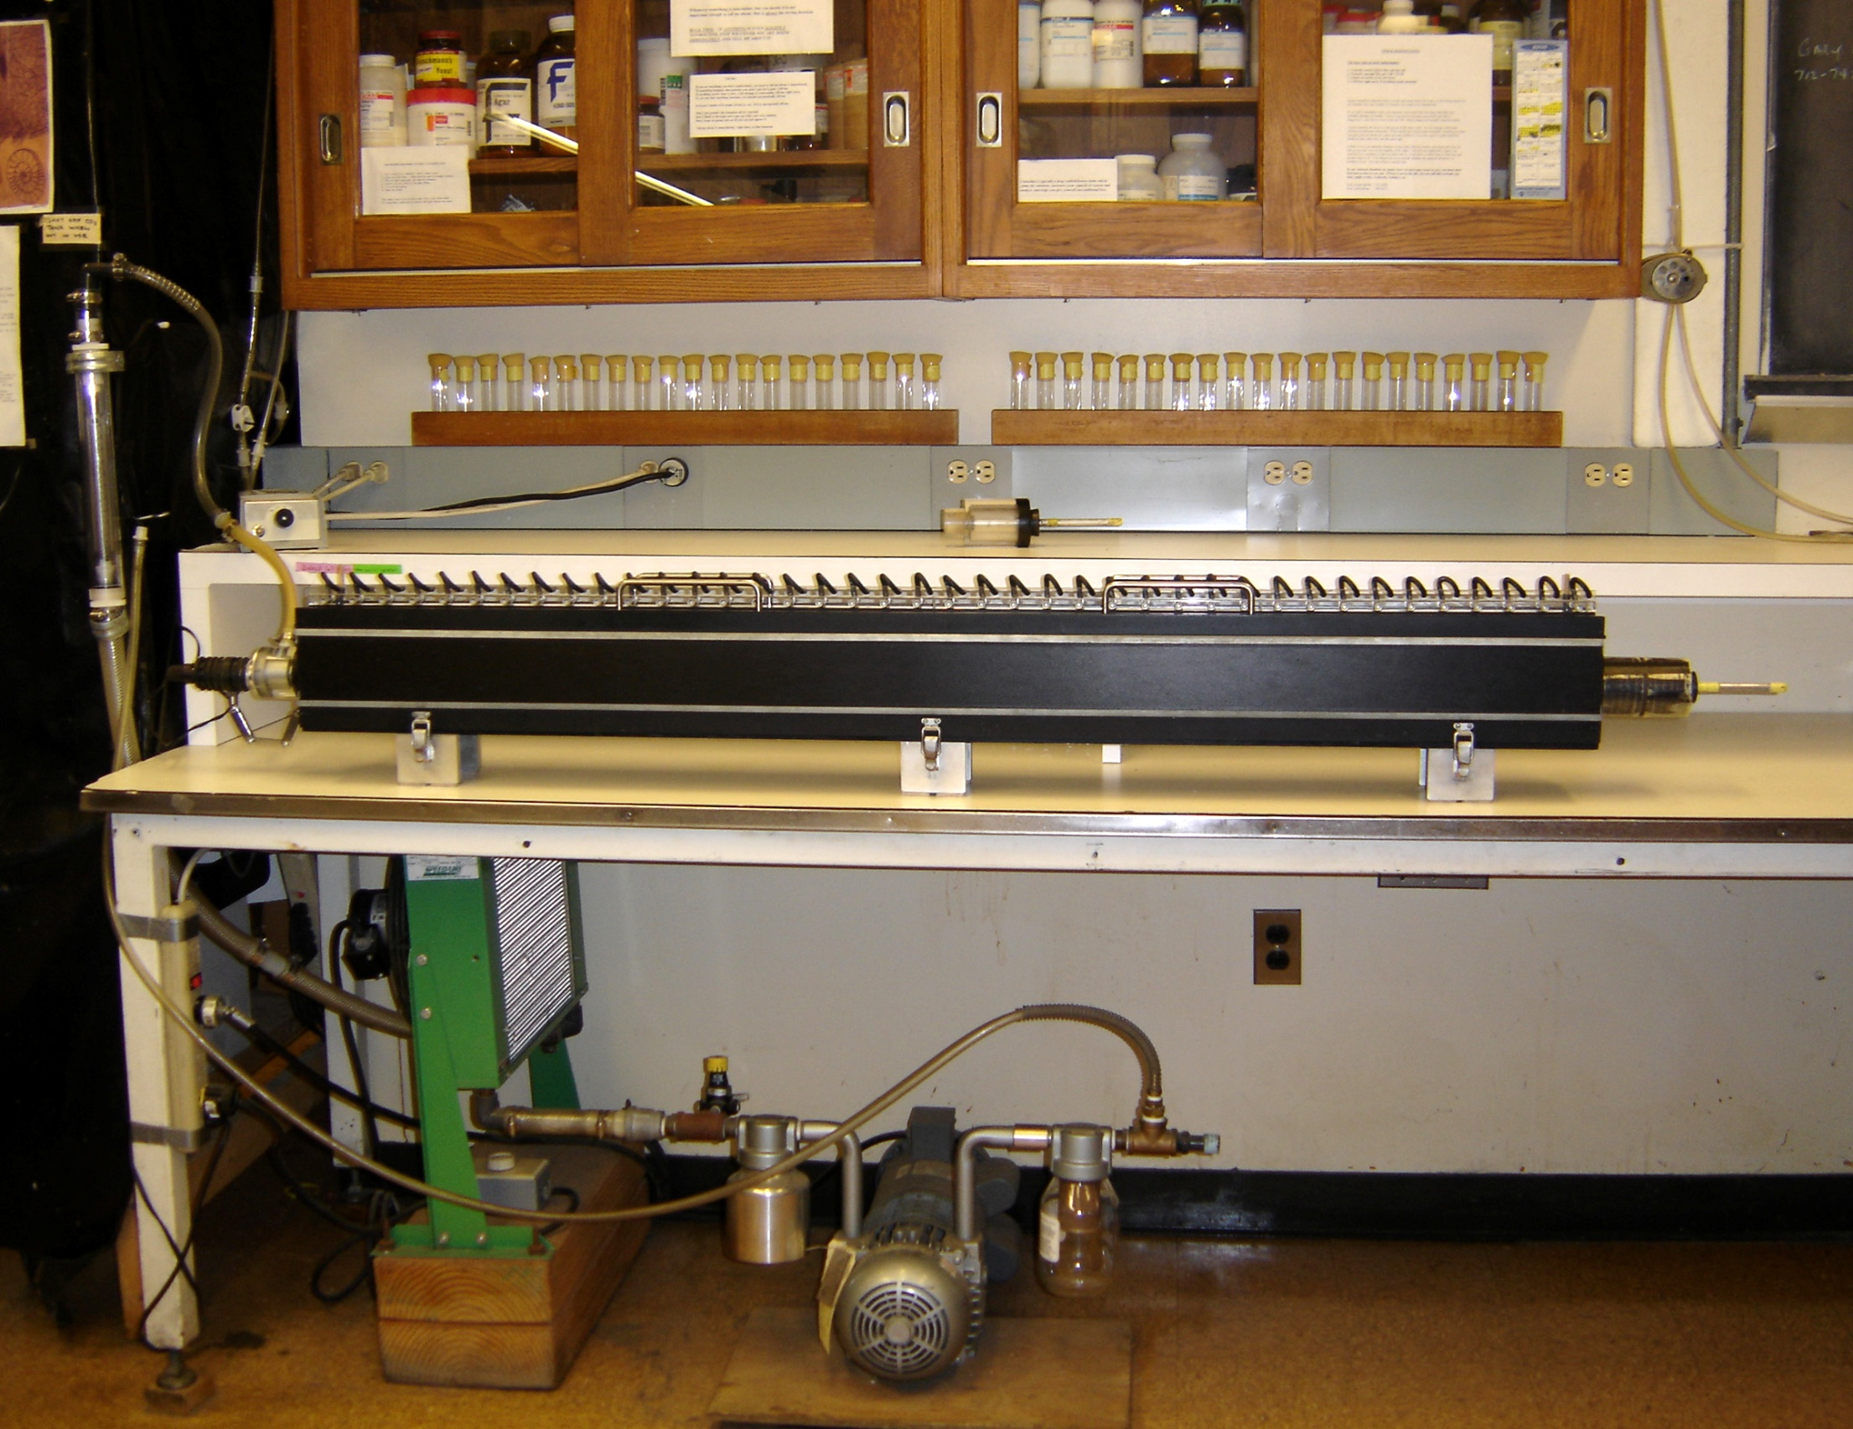
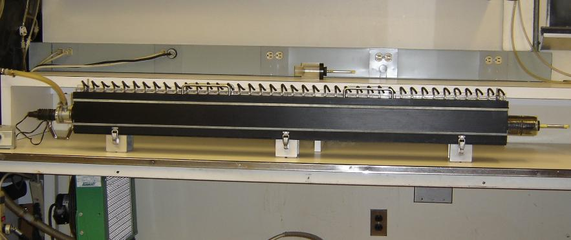
How does flying performance depend on sex and body size, in highly selected wind tunnel flies?
Background: Flies have been selected for high performance in a wind tunnel—flying toward a light, against the wind—for 510 generations. The selected lines have evolved strong increases in attraction to light and flying speed. They score about 100 times as high as the ancestral (control) populations. We are now assessing the many genetic effects which underlie and are correlated with this extreme and rapid response to selection.
The Wind Tunnel (150 cm long)
Conclusions: Females are the overall “winners” in every group of flies—i.e., they have the fastest average speed and the fastest individuals. But males are actually very much faster than females, for their size. Females are slower for their size—probably because they carry heavy ovaries full of eggs. This makes them less efficient . Males have no such “excess baggage” to slow them down.
The Problem: The average speed of flies in selected lines is consistently higher for females than for males. Females are also larger than males on average. In general, larger flies can fly faster than smaller flies. Accurate measurements are now required to find out how performance depends on body size in males and females. Do females fly faster than males only because they are larger, or is one sex actually faster for its size?
The Experiment: We routinely measure flying speeds every generation on a sample of a few hundred flies. These are separated into 40 compartments according to their performance. The result is a normal distribution. For this experiment, we transferred the flies from each numbered compartment into a numbered holding vial. We then separated the flies from each compartment into males and females under a stereomicroscope, recorded the numbers of males and females for each compartment, and returned the flies to separate numbered vials, one for each sex. We then took out the fastest and slowest 20 individuals in each sex . Each group of 20 flies was weighed by placing them in a previously tared cryogenic vial to prevent moisture loss. The mean flying speed for each group of 20 fast or slow males or females

